Slide 1
Adversarial examples for silhouette-based gait recognition
Yifan Xu, Cong Lin, ZiJia Chen

Slide 2
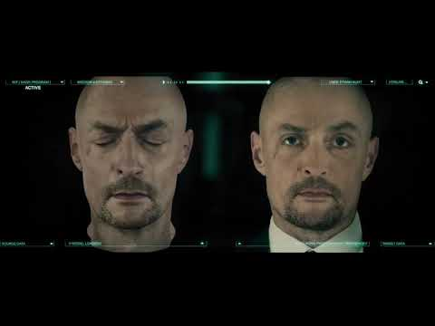

Slide 3

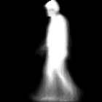
So what is GAIT Recognition?
GAIT Recognition is one kind of biometric technology that can be used to monitor people without their cooperation. Some researchers are working on visually-based systems that use video cameras to analyze the movements of each body part—the knee, the foot, the shoulder, and so on.
(Silhouette-Based GAIT)
Silhouette
GEI (Gait Energy Image)

Slide 4
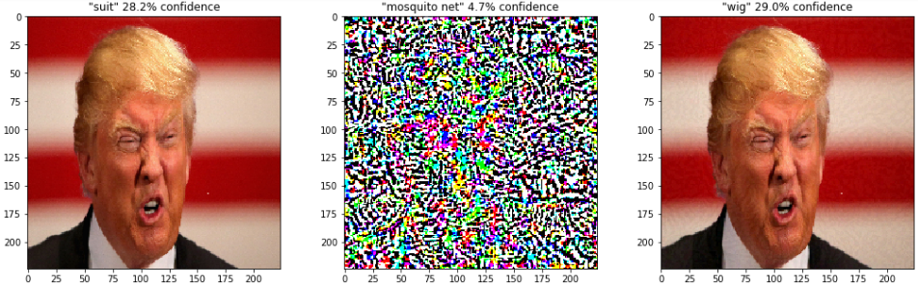
However!
“Adversarial examples in deep learning” by grégory châtel. 2017
it has been demonstrated that deep neural networks are vulnerable to adversarial example attacks as we discussed on class, which will jeopardize the whole security system. In this project, we particularly studied and designed adversarial examples against silhouette-based gait recognition neural networks.

Slide 5
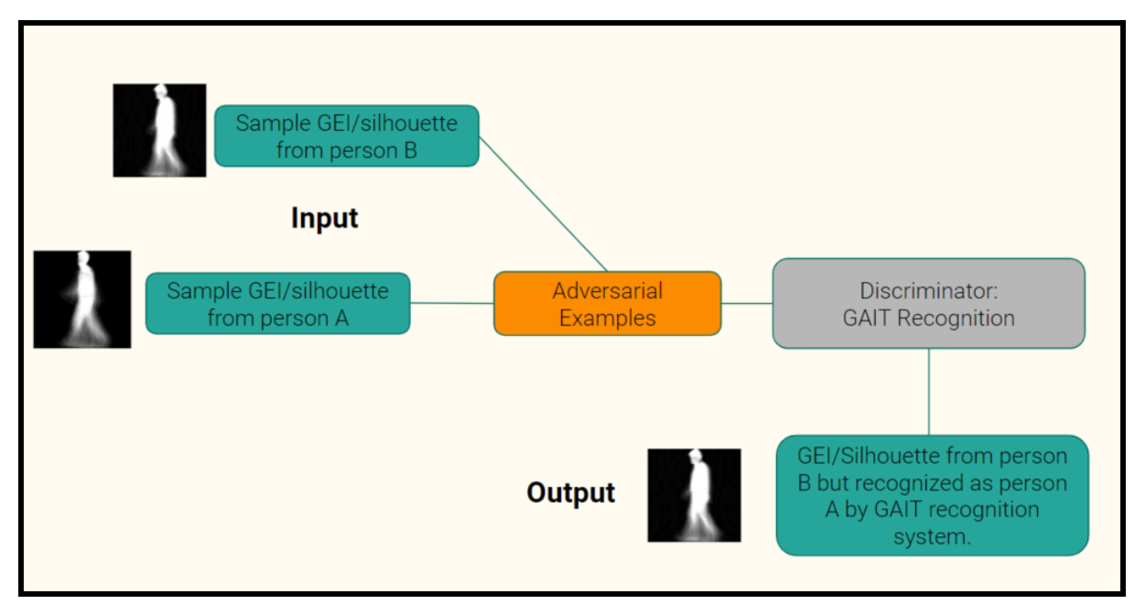
Flowchart of Generating GAIT Adversarial Example

Slide 6
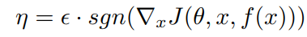
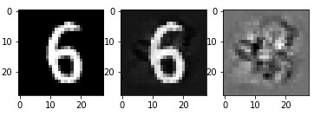
FGSM (Fast Gradient Sign Method)

Slide 7
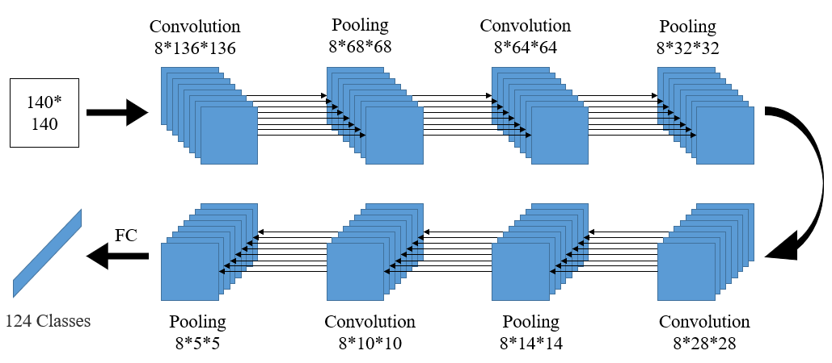
Architecture of Gait CNN

Slide 8
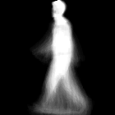
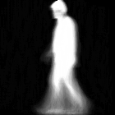
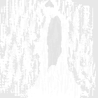
Our GEI Result!
Source image GEI
Gait Recognizer output: 13
Target image GEI
Gait Recognizer output: 75
Created Adversarial Example
GEI and Added Noise
Gait Recognizer output: 75

Slide 9


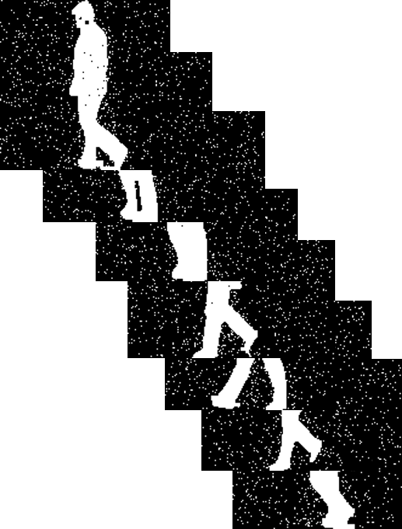

Our Silhouette Result!
Add Noise
Source image Silhouette
Gait Recognizer output: 13
Silhouette Adversarial Example
Gait Recognizer output: 75

Slide 10
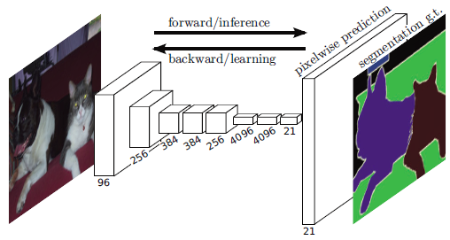
Against Entire Recognition System
Attack recognition network first.
Resulting adversarial example as target.
Attack segmentation network.
Get real-life adversarial example video.
Long, Jonathan, Evan Shelhamer, and Trevor Darrell.
"Fully convolutional networks for semantic segmentation.
CVPR 2015.

Slide 11
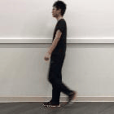


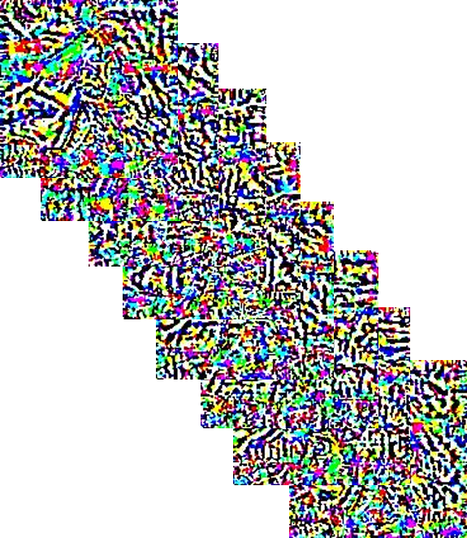
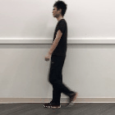
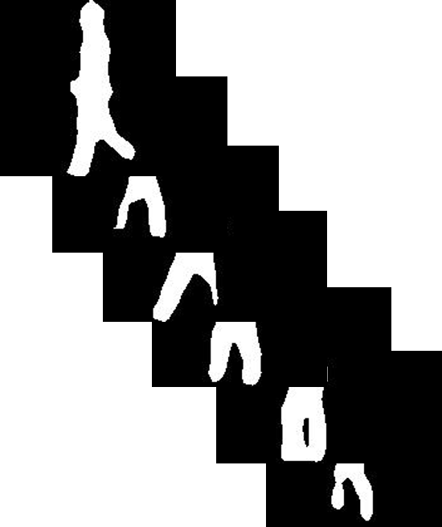
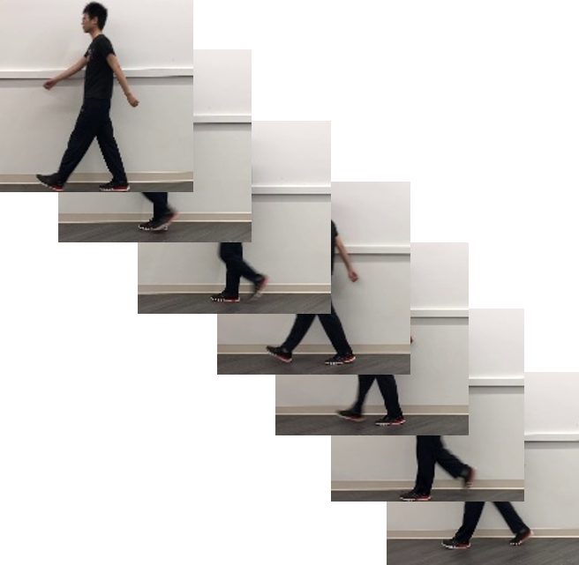
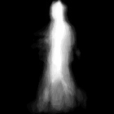
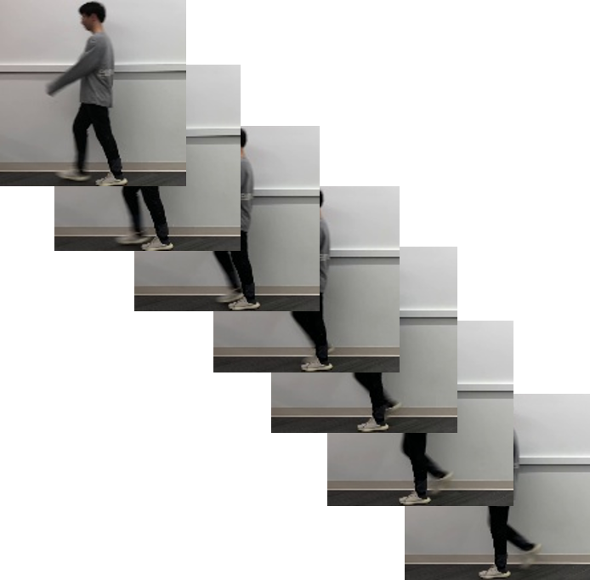
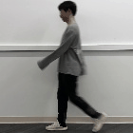

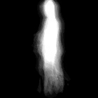
Our Final Result!
GAIT System
Adversarial Example

Slide 12
Problems and Foreseeing
Algorithms: Inconsistent adversarial examples - Need consistent algorithms on none-end-to-end model (pipeline).
Data: New datasets and more comprehensive set of perturbations.
Move to Stronger Segmentation Network and Recognition Network

Slide 13
Questions

Slide 14
Thank you

